Slide 1
IMDB MOVIE ANALYSIS
An Exploration of Movie Success Factors

Slide 2
AGENTA
Introduction
Problem Statement
Data Cleaning and Preprocessing
Dashboard 1: Mean and Median Analysis
Dashboard 2: Standard Deviation and Variance Analysis
Conclusion

Slide 3
INTRODUCTION
The IMDB Movie Analysis project is a thorough exploration into the factors shaping the success of movies on IMDB. Using a robust dataset, the project navigates through data cleaning and employs two interactive Tableau dashboards. The aim is to uncover insights regarding the influence of various elements, such as genres, durations, languages, directors, and budgets, on IMDB ratings and financial success. Through visualizations and statistical analyses, the project provides actionable insights for industry stakeholders, assisting them in making informed decisions for future cinematic endeavors.

Slide 4
TOOL USED
Pandas
NumPy
Seaborn
Matplotlib
Tableau

Slide 5
PROBLEM STATEMENT
In the dynamic landscape of the film industry, understanding the critical factors that contribute to the success of movies on IMDB is paramount for informed decision-making. This project seeks to unravel the intricate relationships between various movie attributes, such as genres, durations, languages, directors, and budgets, and their impact on IMDB ratings and financial success. By leveraging a comprehensive dataset, the analysis aims to provide actionable insights for movie producers, directors, and investors, enabling them to make informed decisions in future projects and enhance the overall success of their cinematic endeavors.

Slide 6
DATA CLEANING AND PREPROCESSING
Steps taken to clean the data:
Handling null values
Changing data types
Creating a new Excel file

Slide 7
Dashboard 1 - Mean and Median Analysis

Slide 8
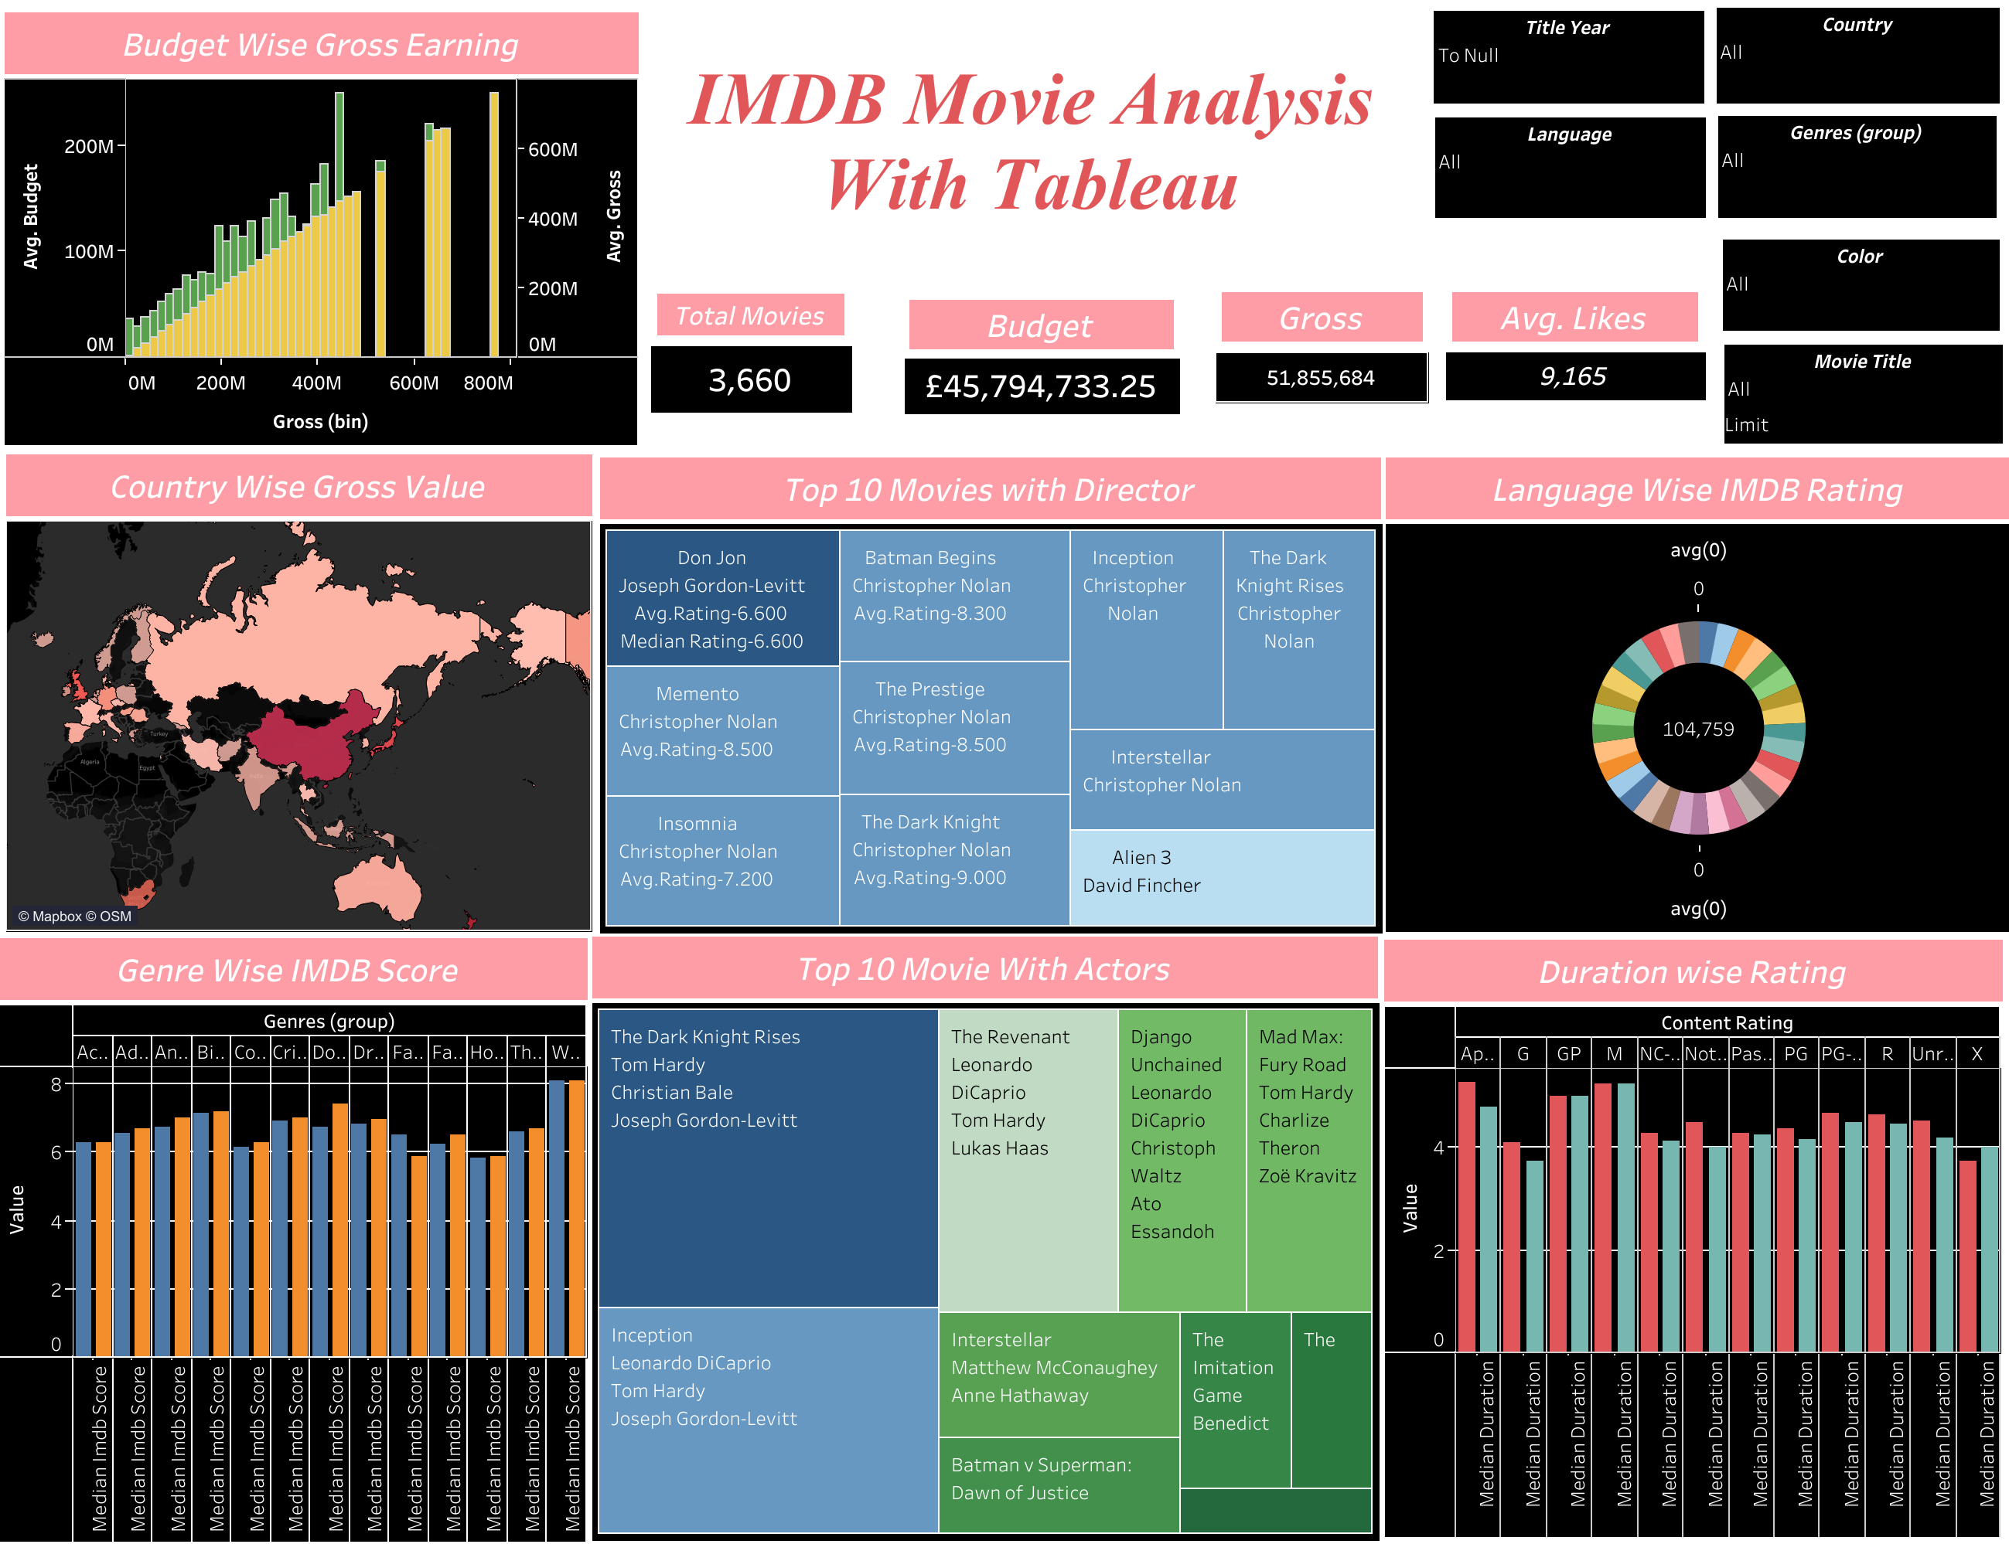

Slide 9
Gross-wise IMDB Score
Visualization:
Bar chart displaying gross-wise IMDB scores with mean and median.
Significance:
Highlighting the distribution of IMDB scores based on movie gross earnings.
Understanding the central tendency with mean and median values.

Slide 10
Duration-wise Rating
Visualization:
Bar chart illustrating duration-wise ratings with mean and median.
Significance:
Analyzing the relationship between movie duration and IMDB ratings.
Identifying patterns in ratings based on movie lengths.

Slide 11
Country Details Map
Visualization:
Map visualizing movie details by country.
Significance:
Geographical representation of movies and their associated statistics.
Insight into the global distribution of successful movies.

Slide 12
Language-wise IMDB Score
Visualization:
Pie chart displaying language-wise IMDB scores with mean and median.
Significance:
Illustrating the distribution of IMDB scores across different movie languages.
Highlighting languages with higher mean and median ratings.

Slide 13
Top Movies with Actors and Directors
Visualization:
Treemaps showcasing top movies with actors and directors.
Significance:
Visual representation of the most successful movies and their key contributors.
Information on budget, cast, and Facebook likes.

Slide 14
Budget-wise Gross Earnings
Visualization:
Bar chart illustrating budget-wise gross earnings.
Significance:
Analyzing the relationship between movie budget and financial success.
Identifying patterns in gross earnings based on budget categories.

Slide 15
Top Movies with Directors
Visualization:
Treemaps showcasing top movies with directors.
Significance:
Visual representation of the most successful movies and their directors.
Information on director name, movie title, IMDB scores, Title Year and Facebook likes.

Slide 16
Dashboard 2 - Standard Deviation and Variance Analysis

Slide 17
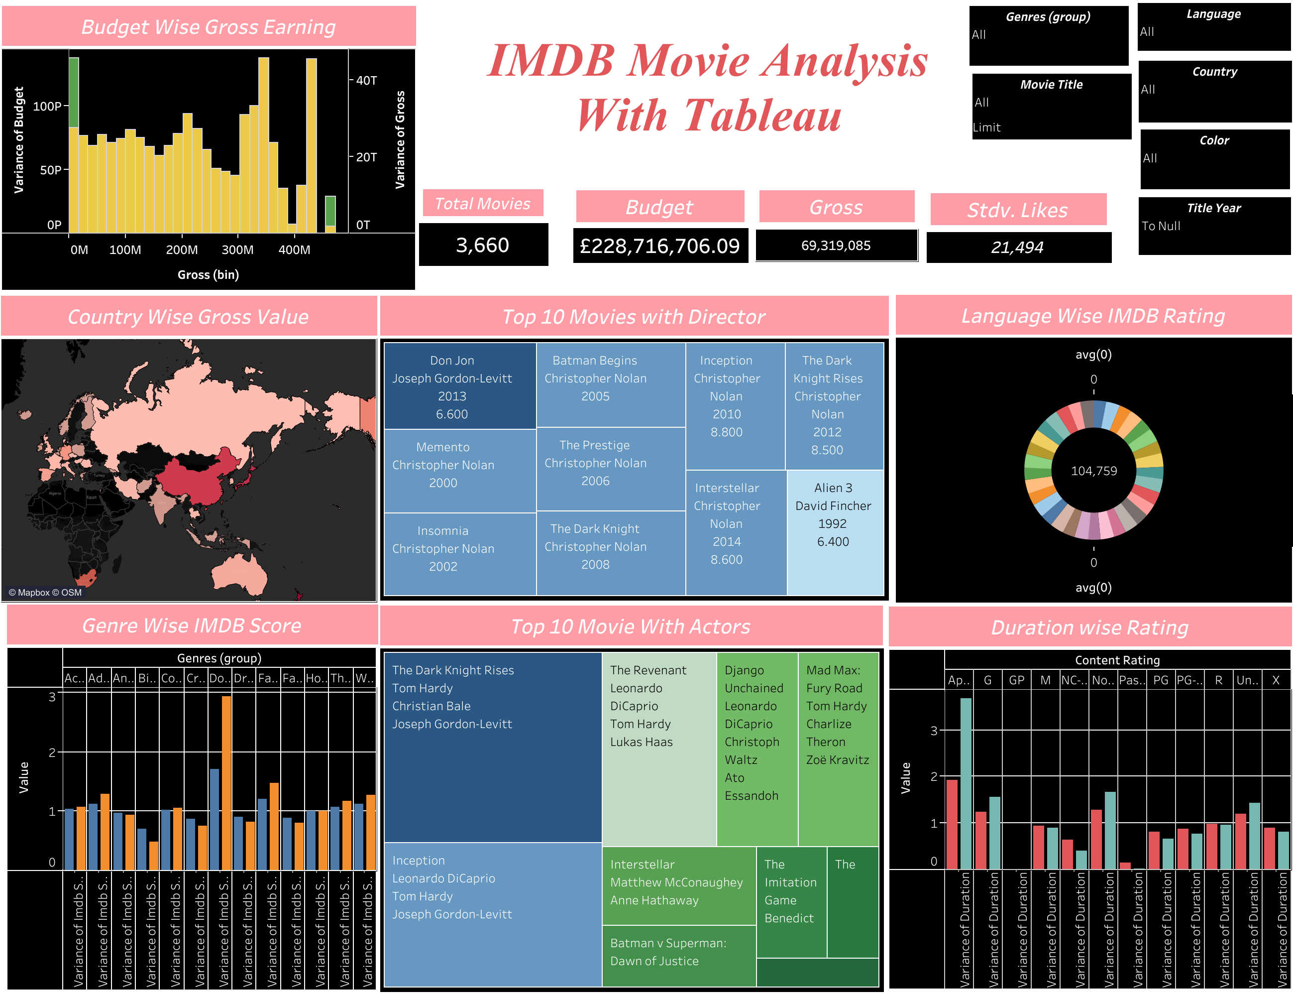

Slide 18
Gross-wise IMDB Score
Visualization:
Bar chart displaying gross-wise IMDB scores with standard deviation and variance.
Significance:
Examining the dispersion of IMDB scores based on movie gross earnings.
Understanding the variability in ratings for different gross categories.

Slide 19
Duration-wise Rating
Visualization:
Bar chart illustrating duration-wise ratings with standard deviation and variance.
Significance:
Analyzing the variability in IMDB ratings based on movie duration.
Identifying the range of ratings for different movie lengths.

Slide 20
Country Details Map with Gross
Visualization:
Map visualizing movie details by country, incorporating gross standard deviation and variance.
Significance:
Geographic representation of movies with additional emphasis on rating variability.
Insight into how IMDB scores vary within different countries.

Slide 21
Language-wise IMDB Score
Visualization:
Pie chart displaying language-wise IMDB scores with standard deviation and variance.
Significance:
Illustrating the dispersion of IMDB scores across different movie languages.
Highlighting languages with higher standard deviation and variance in ratings.

Slide 22
Top Movies with Actors and Directors
Visualization:
Treemaps showcasing top movies with actors and directors, now with standard deviation and variance.
Significance:
Visual representation of variability in success for top movies and key contributors.
Information on standard deviation and variance for IMDB scores.

Slide 23
Budget-wise Gross Earnings
Visualization:
Bar chart illustrating budget-wise gross earnings, including gross standard deviation and variance.
Significance:
Analyzing the variability in financial success based on different budget categories.
Identifying the range of gross earnings for different budget levels.

Slide 24
Top Movies with Directors
Visualization:
Treemaps showcasing top movies with directors.
Significance:
Visual representation of the most successful movies and their directors.
Information on director name, movie title, IMDB scores, Title Year and Facebook likes.

Slide 25
CONCLUSION
The IMDB Movie Analysis project has successfully unraveled the nuanced dynamics influencing movie success on IMDB. Through meticulous data cleaning and insightful visualizations, we've highlighted key factors like genres, durations, languages, directors, and budgets. The project's interactive dashboards provide actionable insights, empowering stakeholders with valuable information for informed decision-making in the dynamic world of cinema.

Slide 26


